Slide 1
Unique Corns
Parth Champaneri, Allen Hsiao, Clare Kim,
Pascal Queeney, Patrick Tan

Slide 2
CHI 2019
Theme

Slide 3
The theme of CHI 2019 is ‘Weaving the threads’. In the Student Design Competition, we encourage you to contribute to this theme by considering the ways that technology might be used to strengthen our social fabric

Slide 4
The Problem
Topic

Slide 5
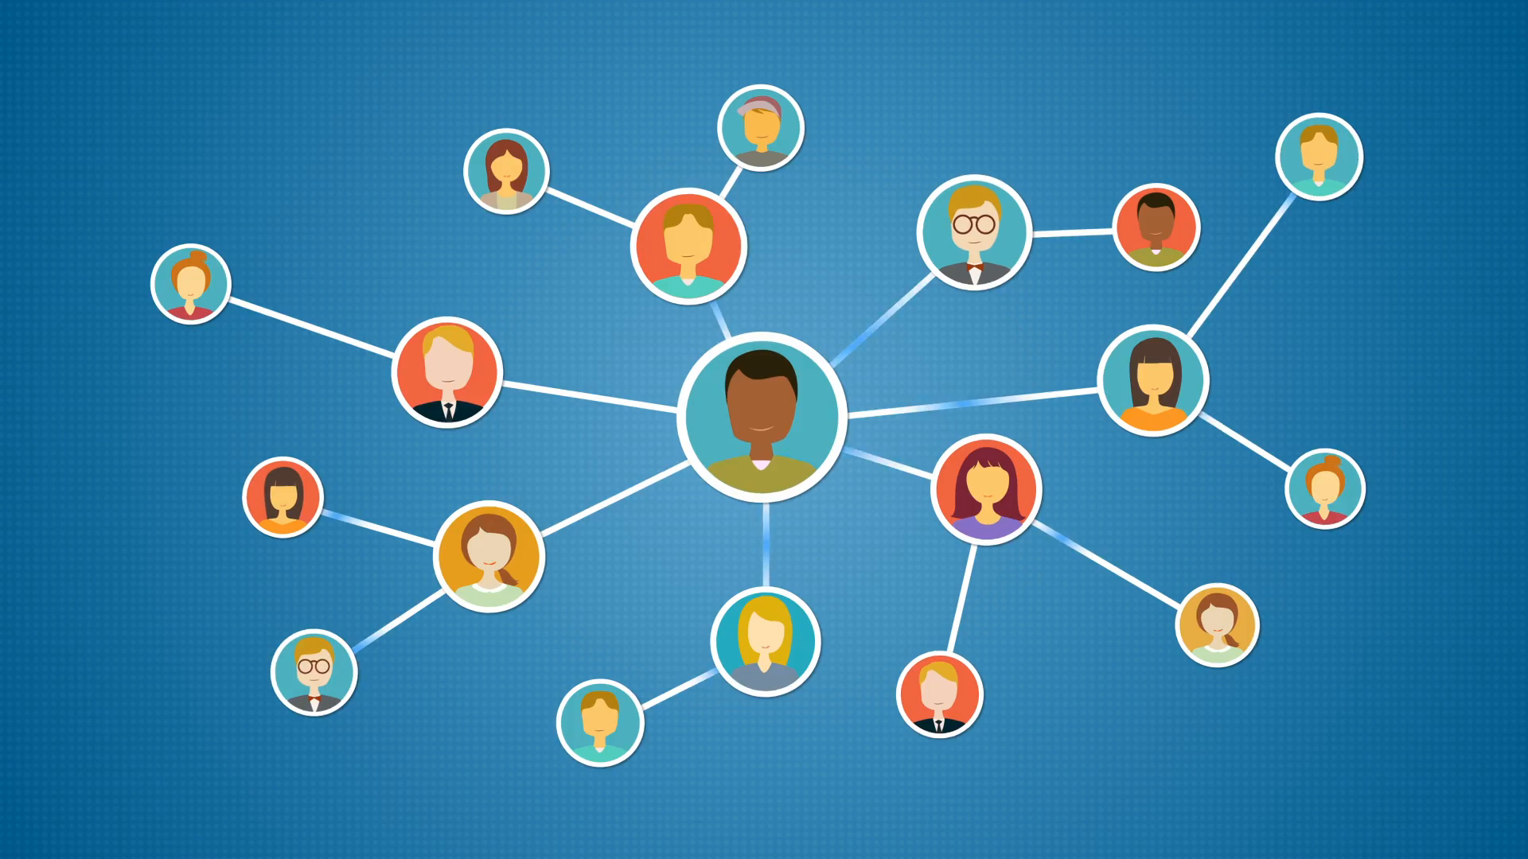
Problem Statement
Transitioning into a new community can be difficult or even challenging for some. We are unaware of many events that happen around us and we miss the opportunity participate in things that interest us as well as a chance to meet new people.
Our vision is to develop a solution which can give people who are new to communities an opportunity to connect with people around them who share the same interests.
Notes:
After iterations of problem statements (connect people share same interest...students...uoft students...connecting uoft student life)...we came up with….

Slide 6
Research
Formative Study #1 and #2

Slide 7
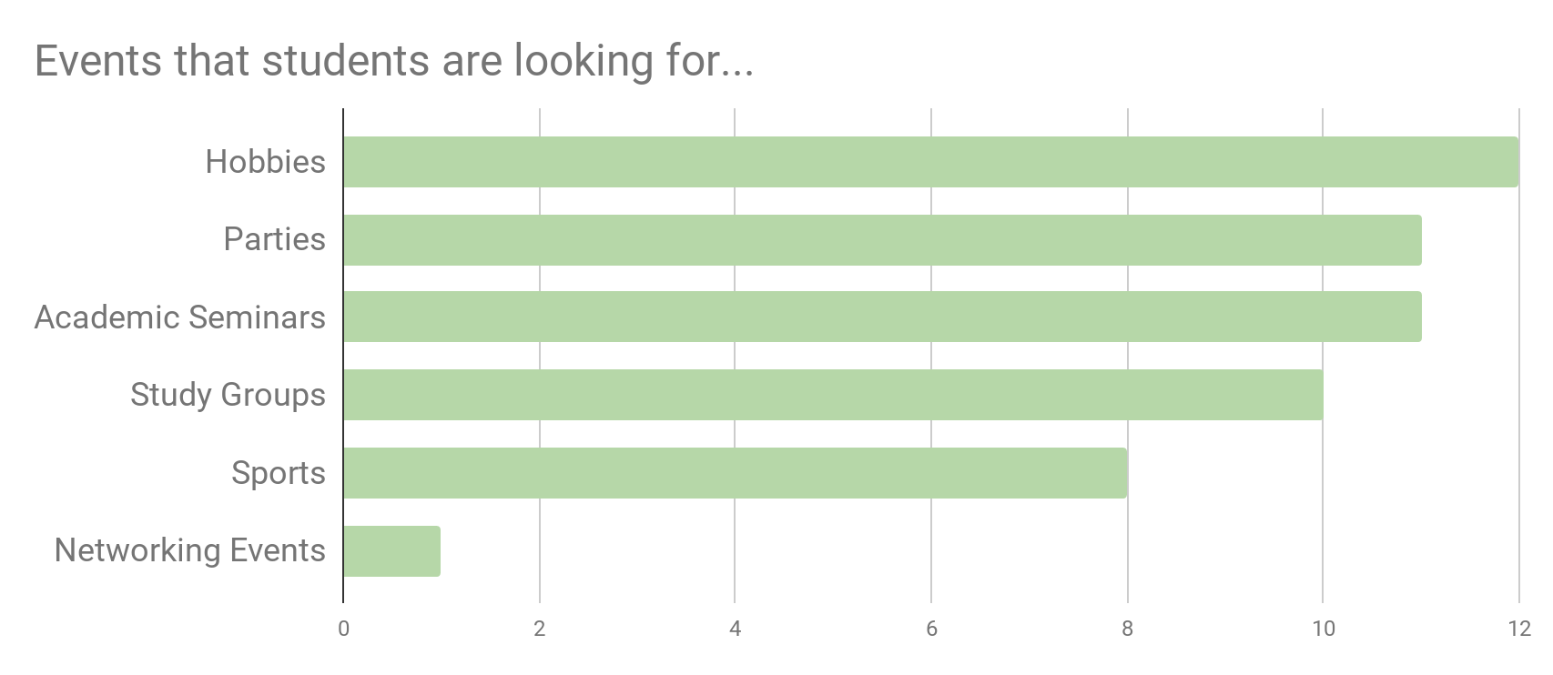
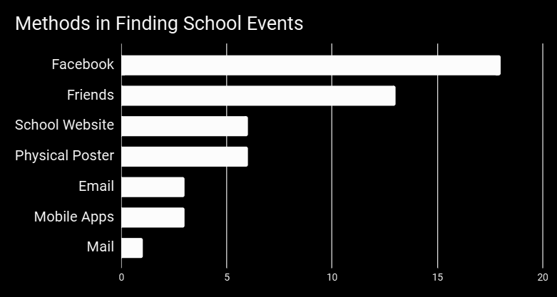
Questionnaire
25 participants
Demographics
Social Media presence
Interests
Current solutions
Notes:
Using google forms, we spread around campus asking students for our questionnaire. These varied of type of student, year, location etc...

Slide 8
Semi-Structured Interview
Follow up participants and new recruited participants
Topic of Interests:
Academic Life vs. Social Life
How to strengthen social circles
Attending events
Coping strategies with social life
Notes:
Here we talk about our revision of problem statment to start focusing on students because it just genrerally made more sense for us

Slide 9

Identified Problems
Balancing academic vs. social life
“Last week I had a bunch of midterms, there were lots of activities my friends wanted to go to, I needed to time manage well to accommodate both academic life and social life.”
Coping Strategy:
“If I know I have a midterm coming up but then my friend also wanted to hang out, I would probably study beforehand so I would have time to go and do stuff after.”

Slide 10
Anxiety + Friends
“maybe for some people it’s due to anxiety, because they need to do all this work in order to go out.”
Coping Strategy:
“I feel like it is sort of intimidating sometimes to go to events and you don’t know anyone. Also with anxiety, it is a lot easier if you went with friends than to go by yourself.”

Slide 11
Refined problem statement:
We would like to focus on making connections between students and their fellow peers in a course/program to strengthen ties between students and within their academic community.
Our focus is on students who want to balance their academic and social lives.
Specifically on helping students maintain and use their social network to promote a more active lifestyle during their time at school

Slide 12
Job Stories, Design Requirements and Storyboards

Slide 13
Job Stories
When I have a busy schedule and school work, I want to look for social events that fit into my schedule, so I can still have a balance between social life and academic life.
When I cannot find social events that fit my interests, I want to look on social media to see what events my friends are interested in, so I know what events are available and which friends I can go to the events with.
When I have anxiety attending social events by myself, I want to know which friends are attending certain events, so I can ask them to attend with me. So I will be more comfortable at the event.
When I know I have assignments and midterms coming up, I want to know what events are available far in advance and finish my work early, so I do not have to stress when I attend the social event.
When I am looking to make friends at school and join more social events, I want to look into becoming a member of a student club that I am interested in. So I can follow up on the events hosted by that club and meet people that have the same interest as me.

Slide 14
Design Requirements
The design must incorporate social media, either being a feature on social media as an extension, or allows users to connect to their social media.
There must be a feature on the solution that can allow users to connect with friends and look at what events their friends are planning to participate in
The solution design should focus on the problem we set up specifically, and should not be too general
The audience for the design is tailored for students, therefore the design should focus on being for students, but also be able to accommodate for different types of students.
The design of the product should protect the user’s privacy and information.

Slide 15
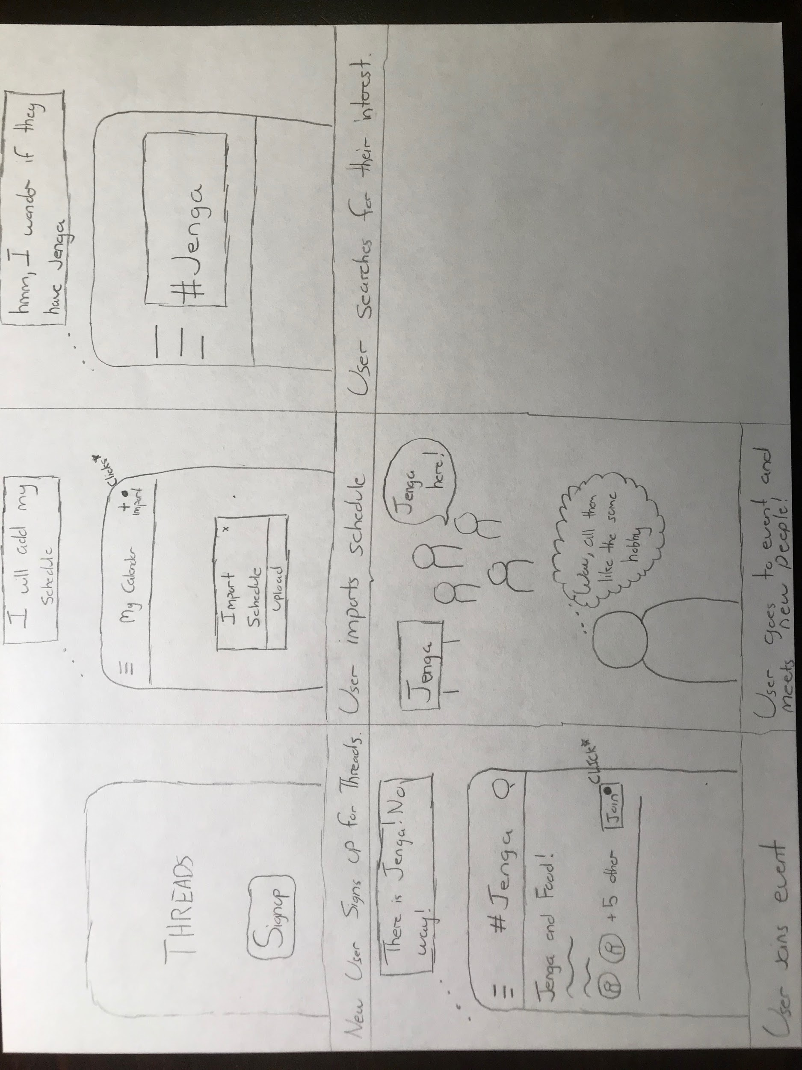
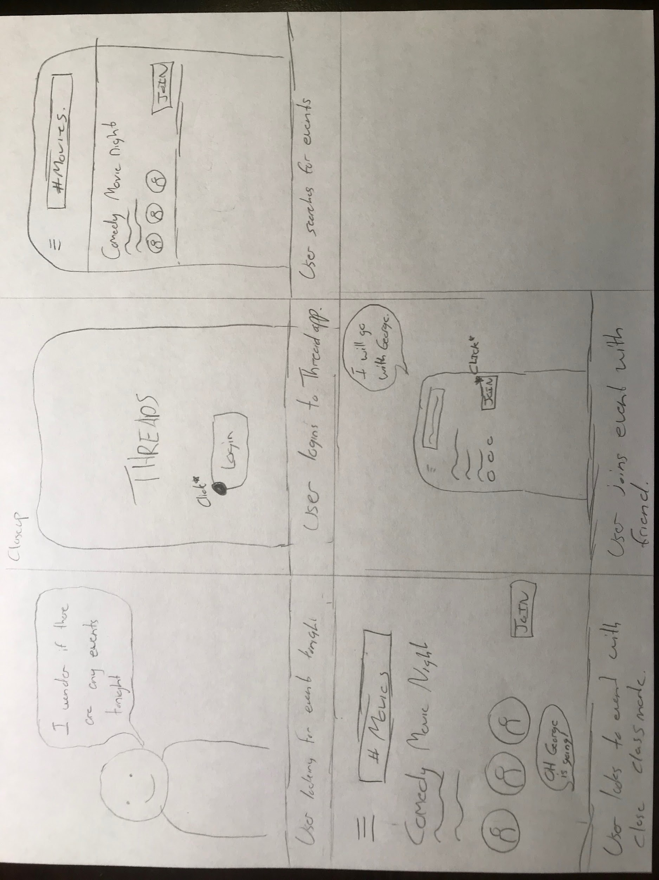
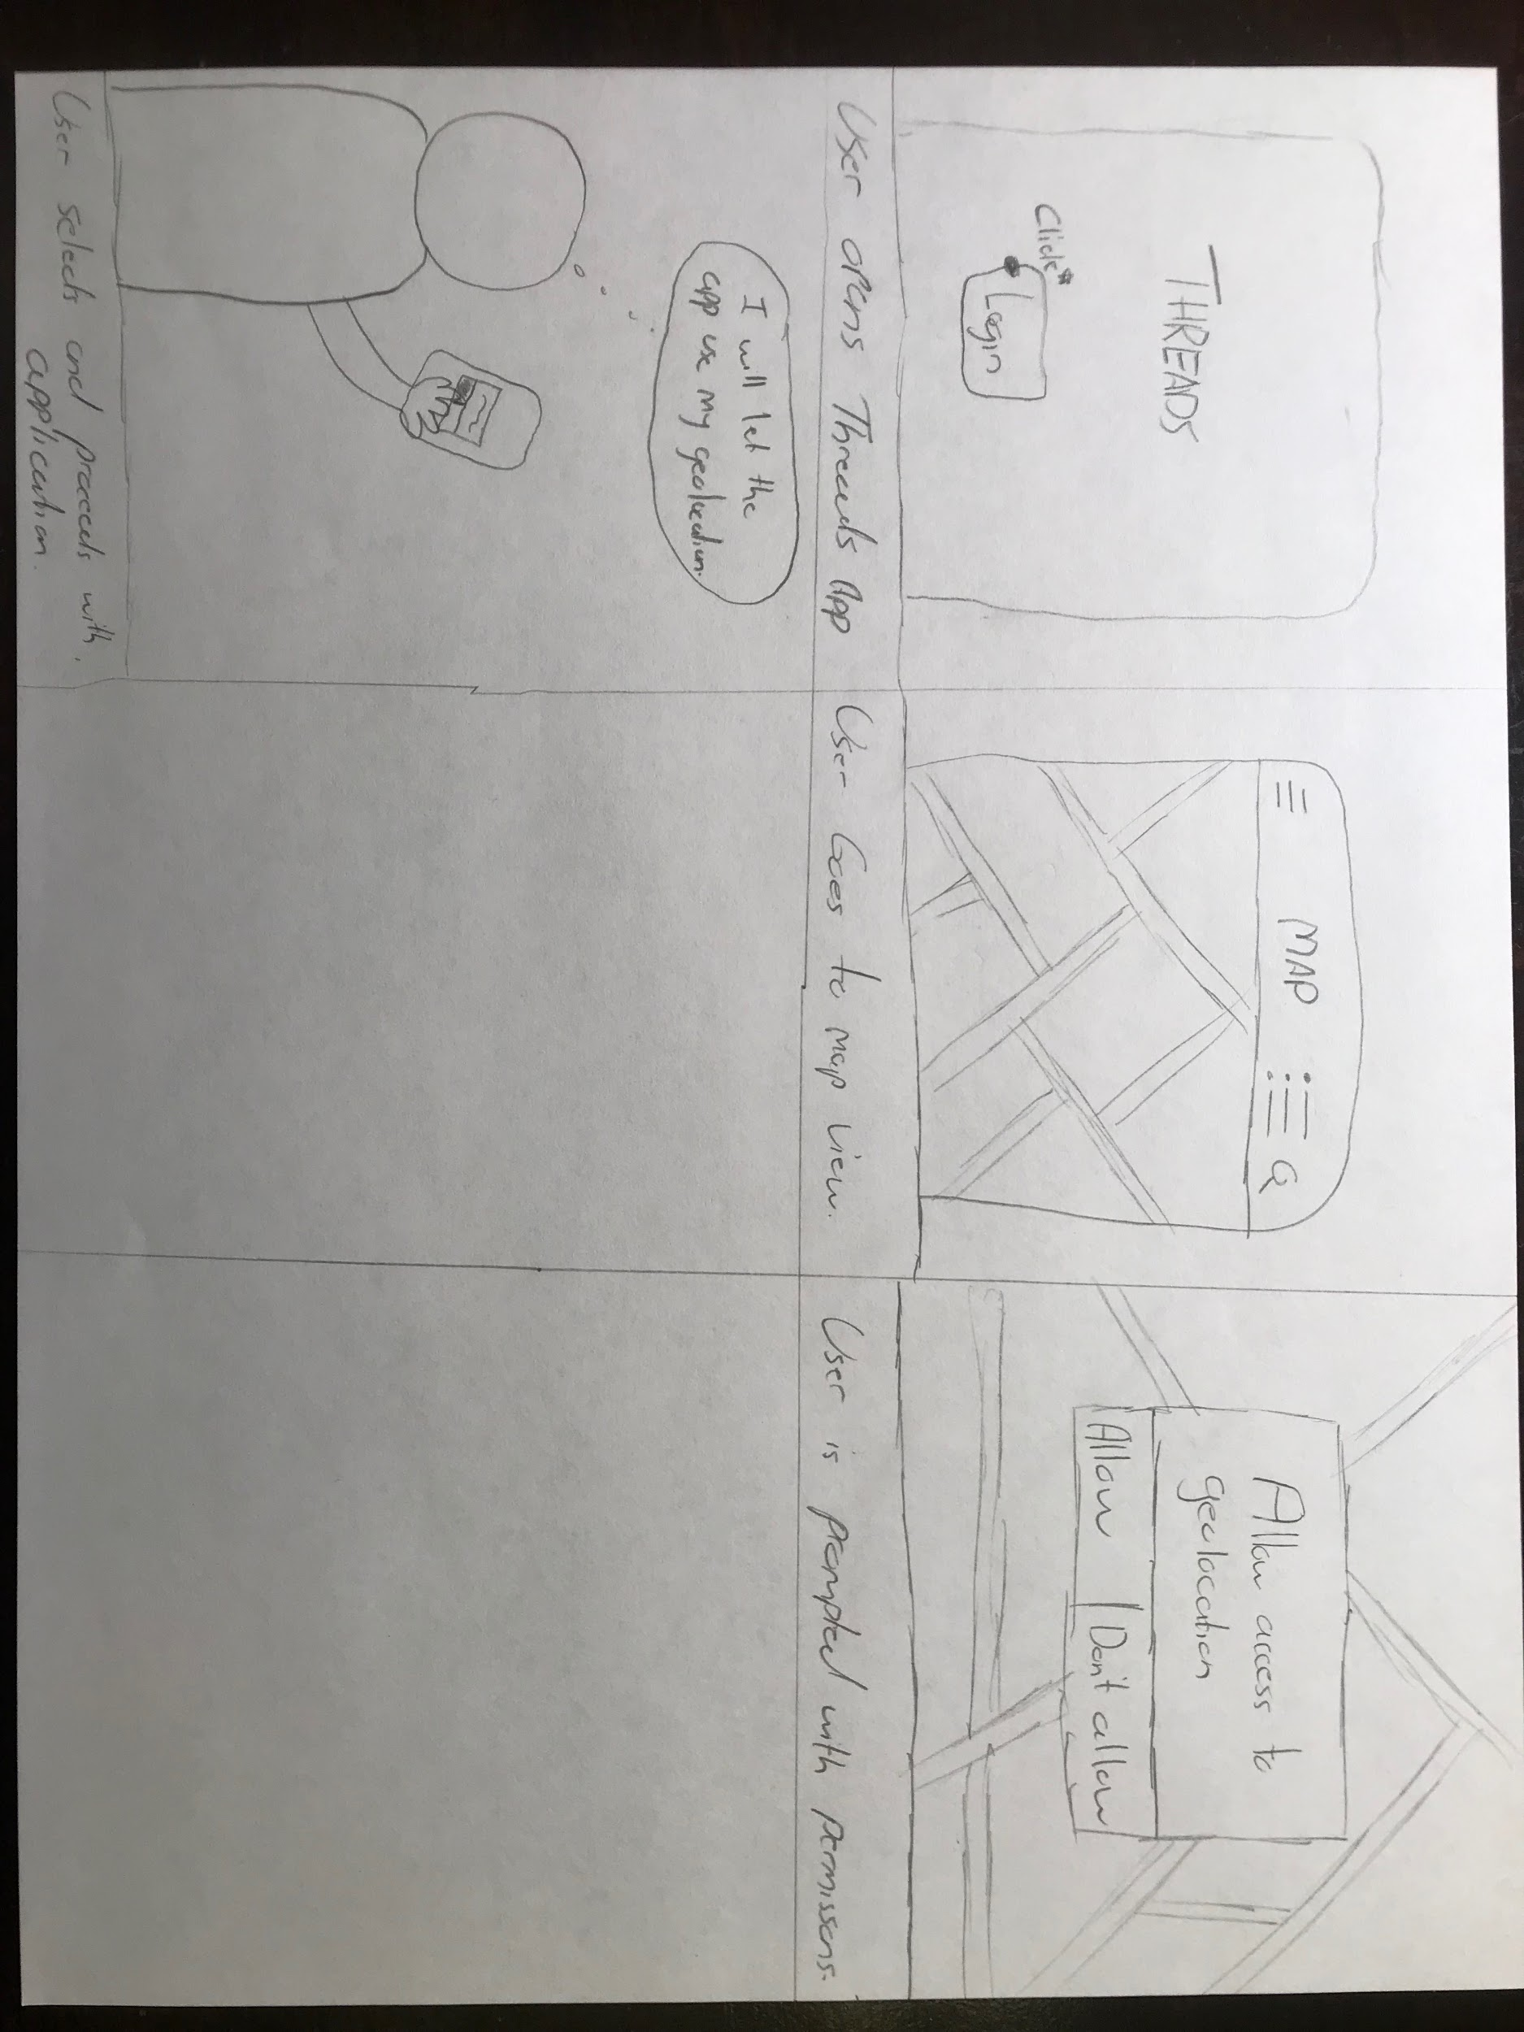
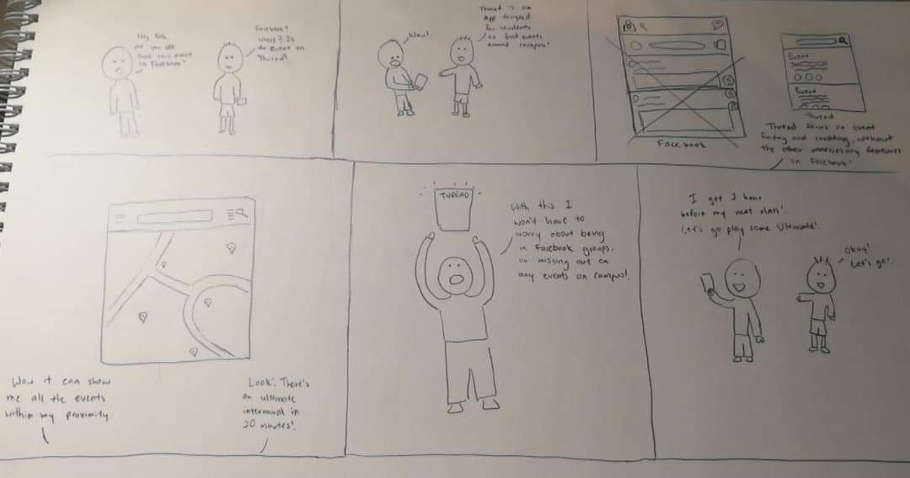
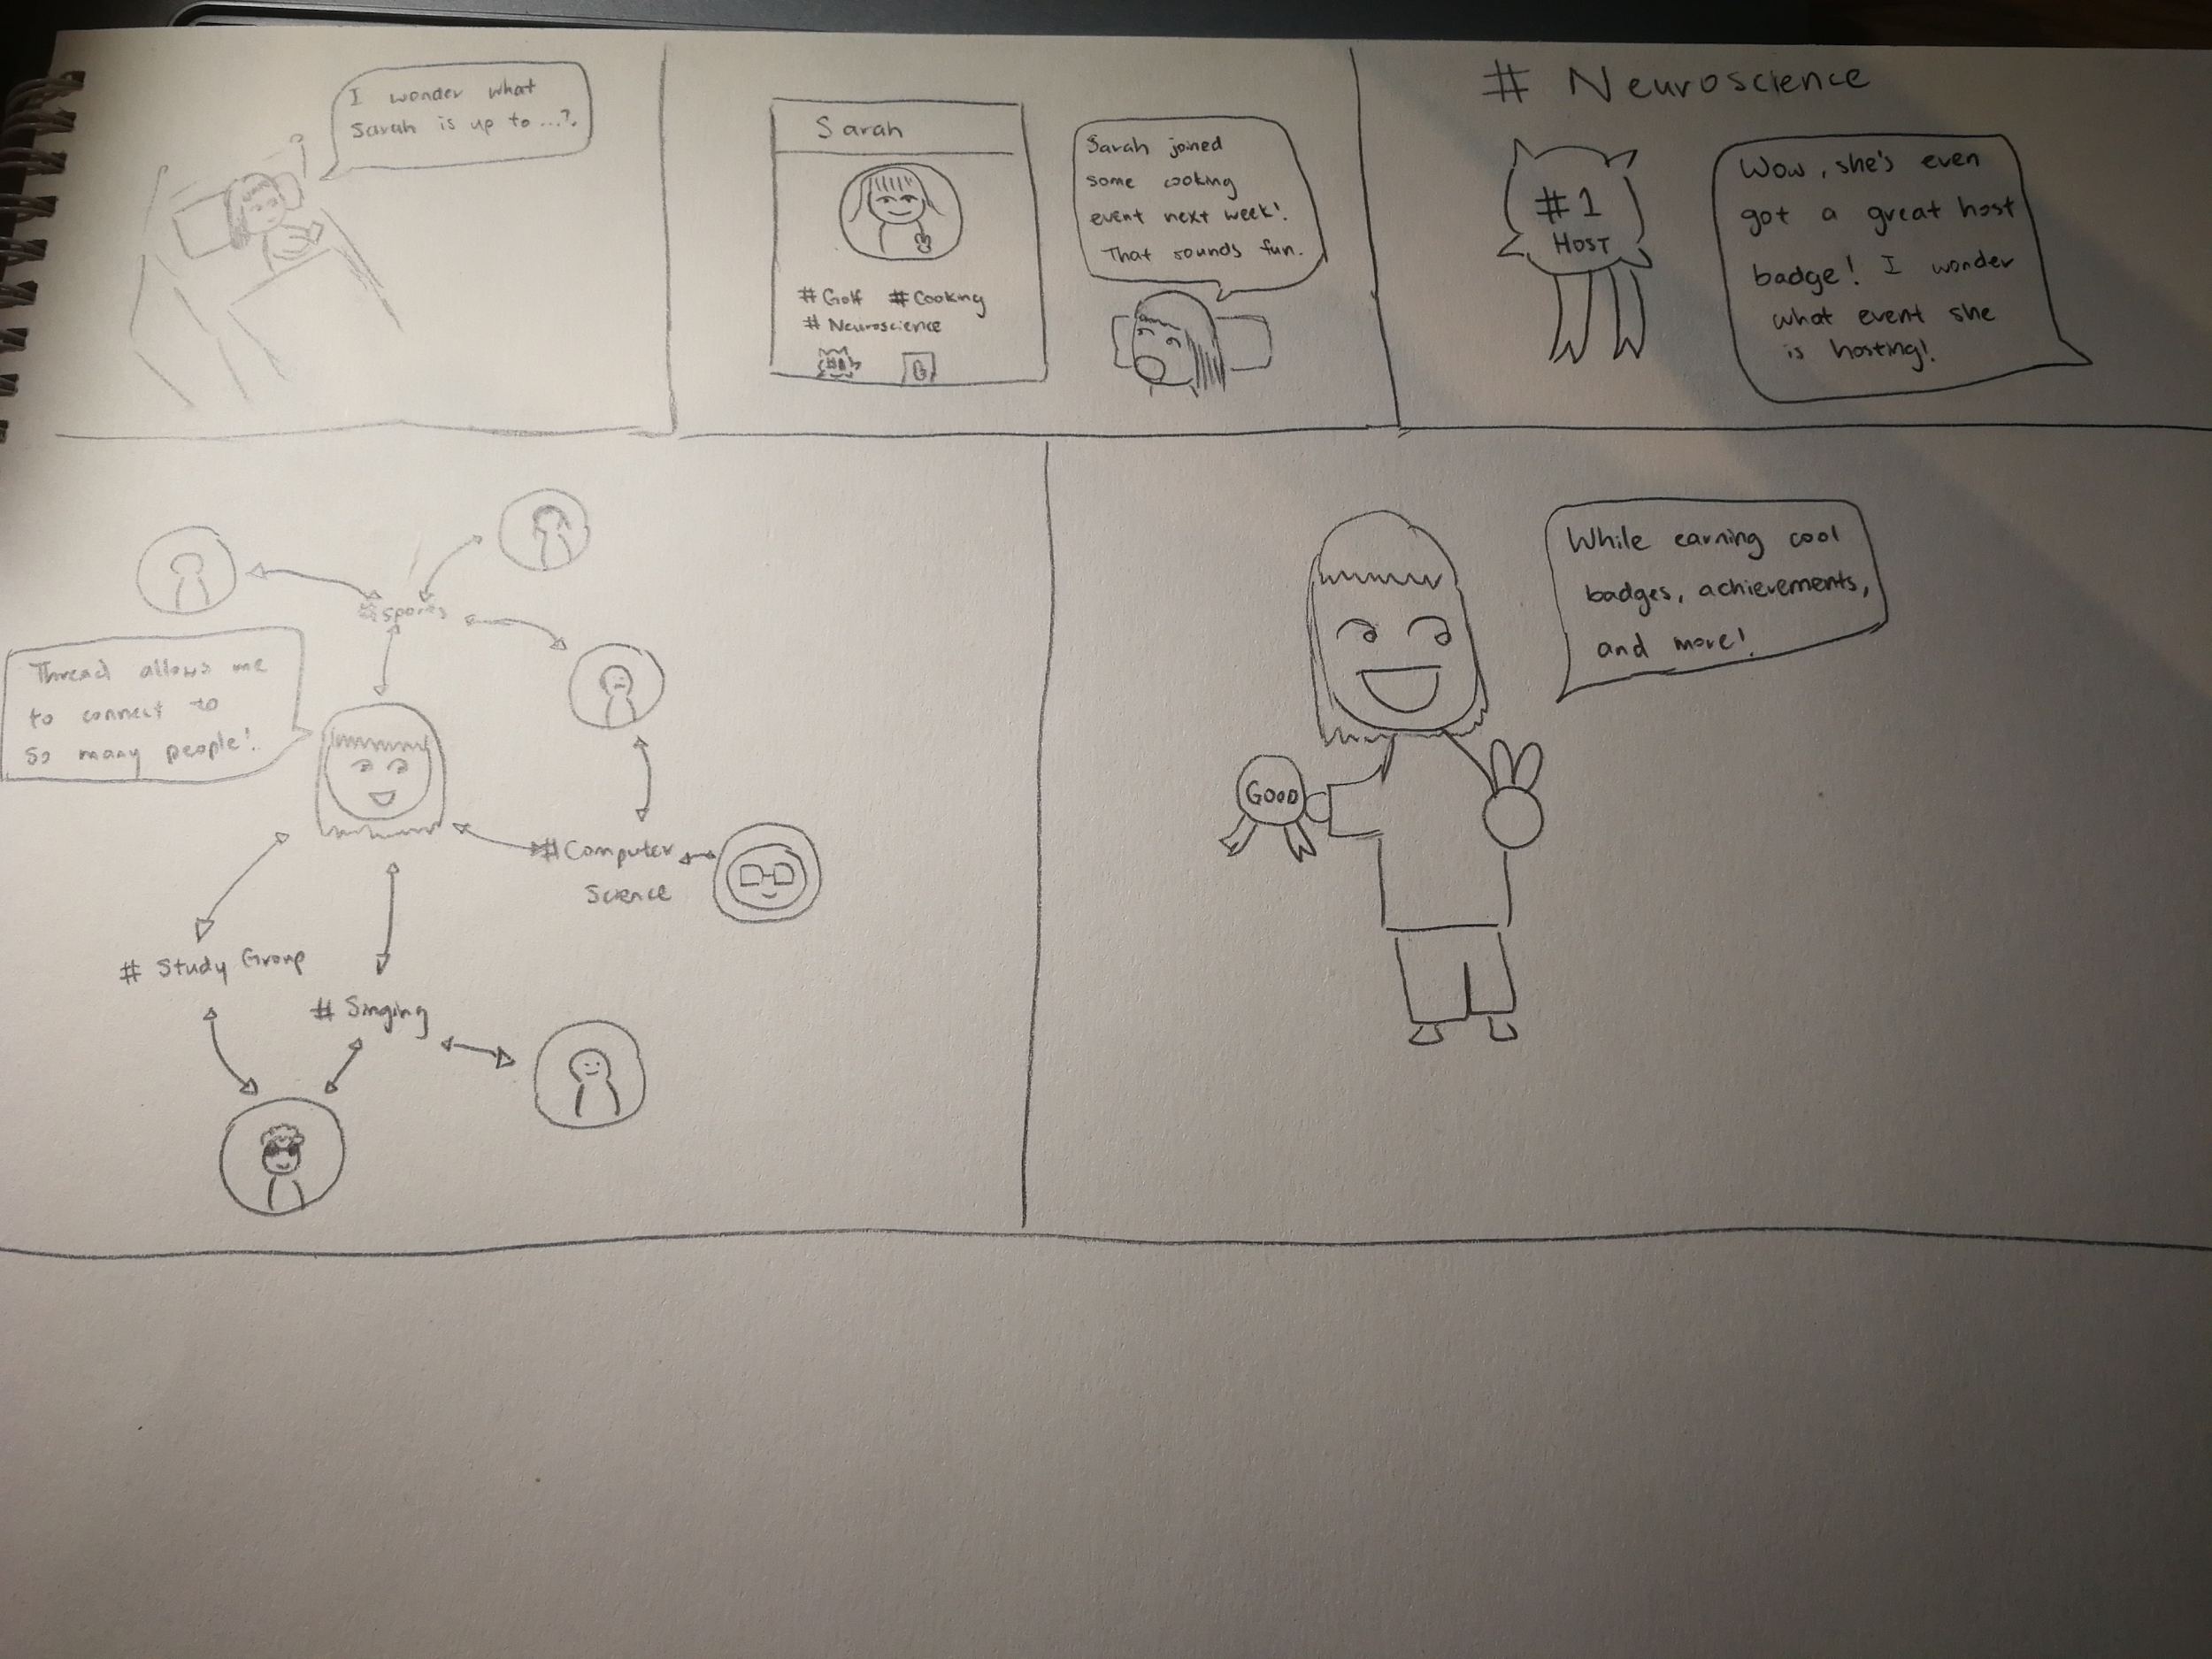
Storyboards
Notes:
Omg this story board T.T -allen its adorable :S haha-pat

Slide 16
Sketches

Slide 17
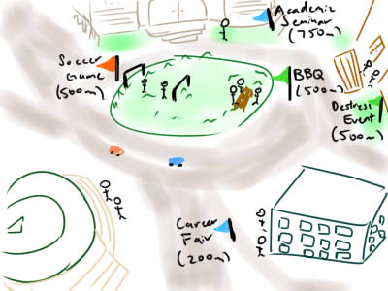
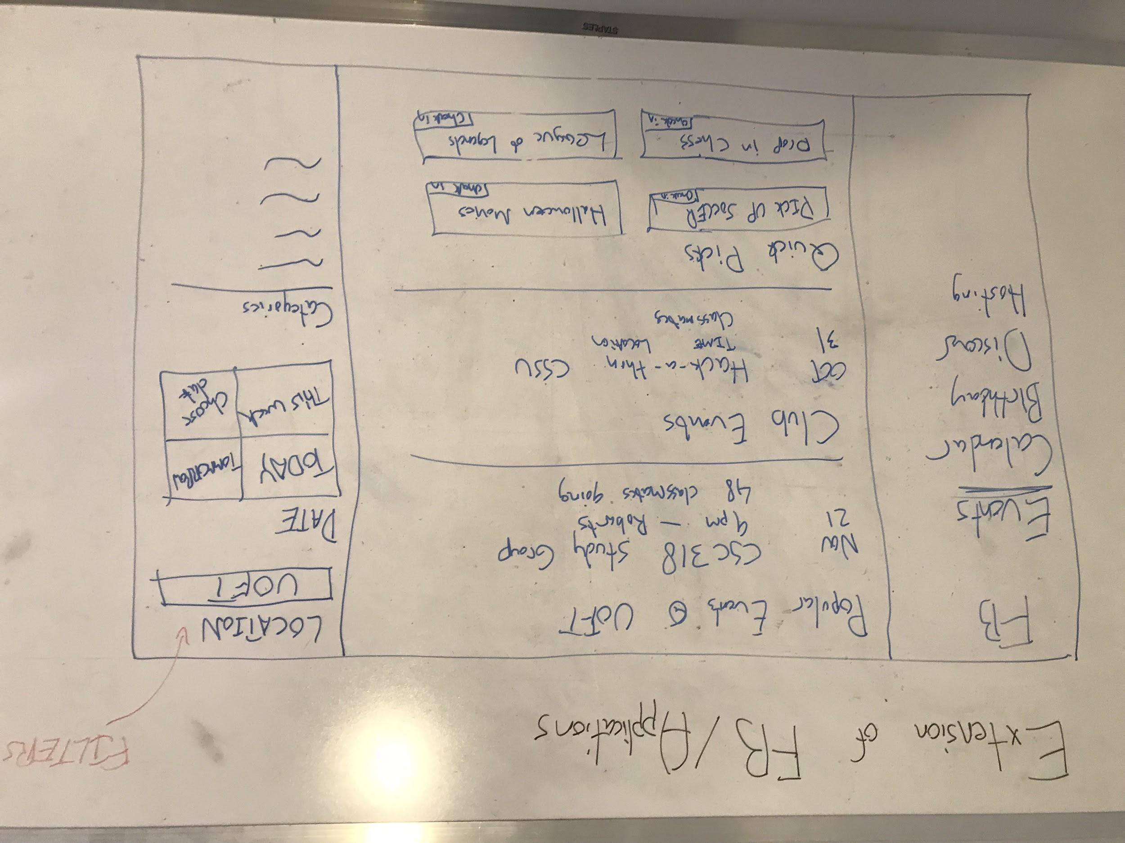
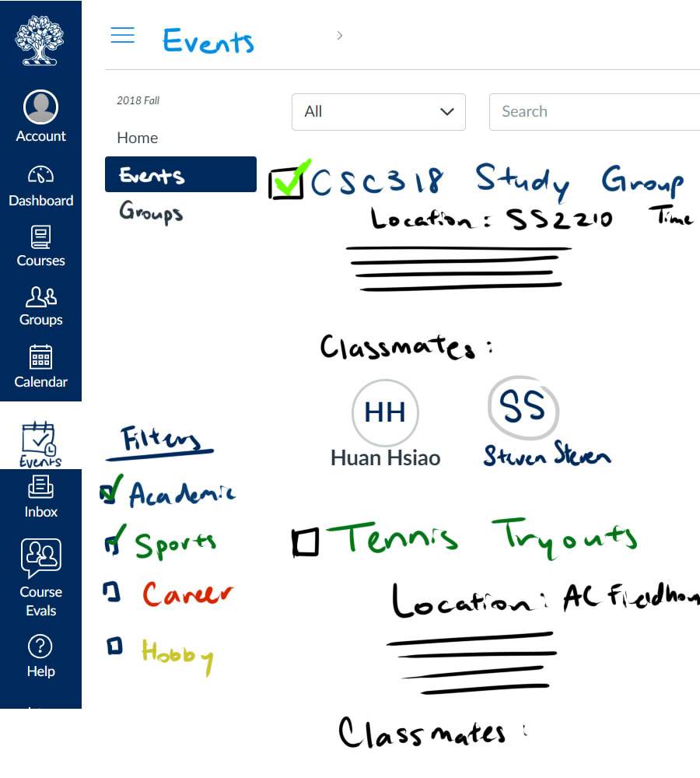
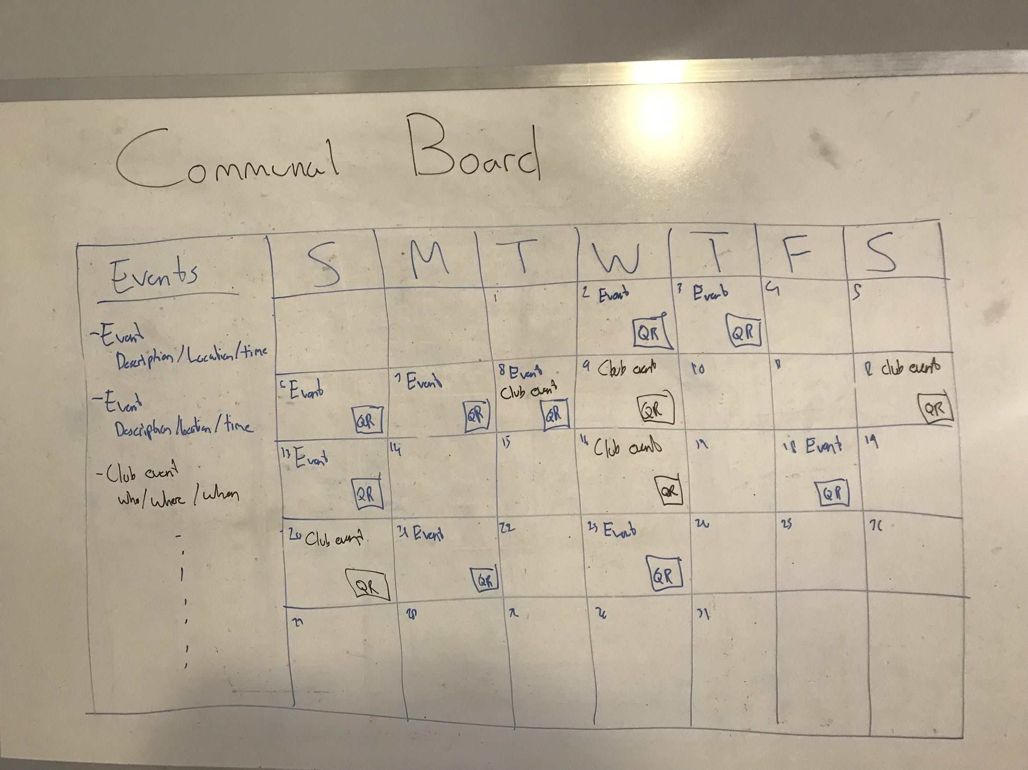
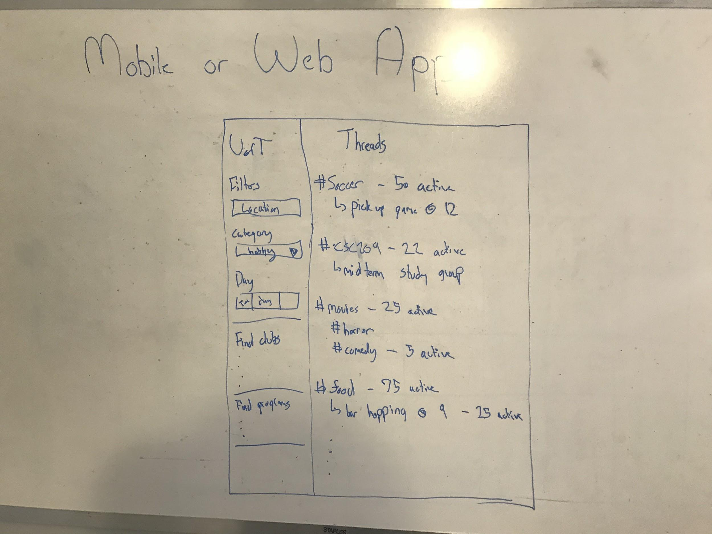
Initial Ideas
Pros
Cons
Encourages drop-in activities without prior commitment
Encourages communal areas within the campus
Physical schedule could make finding events more fun
Hotspots will not always be accessible or usable at times
Cater towards popular hobbies amongst students vs niche hobbies
Can’t plan to go to events in advance - have to walk by the building or be in the area to know event schedule
Traditional, not as widespread as social media
Can become spammed/ crowded
Hard to find
Able to access school information: schedules, classes, faculty
All students have access to Quercus
Already a built-in calendar function, announcements
Quercus already has a set design, not much design freedom
Social media is a convenient tool for students to look for events
Events can be clearly laid out, can see which friends are going
Mobile and website application can be assumed to be the most used technology between university students
Both mobile and website applications are a lot more portable and can be accessed from anywhere
Website and Mobile applications offer more design freedom, whilst developing
Opened to having a variety of events for people who are looking for different types of events
Can see multiple events at once
Calendar good for time managing and scheduling
Might have existing functionality, adding features will make it look too busy
Development can take a long time
Website and Mobile applications are both expensive projects
Generating a user base

Slide 18
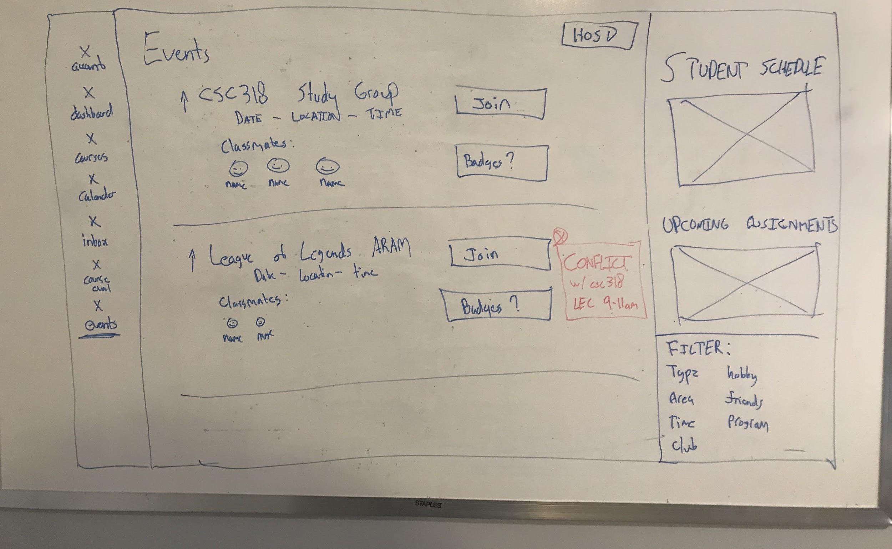
Our Solution
Takeaways
Connecting a student’s time schedule and bringing all events across all different platforms into one location
Reward System
Badges
Schedule, exam conflict easily identified
Colour-coded, built-in calendar
Notes:
We talk about how this was our inital solution, but with feedback after the studio we got to a low-fid...

Slide 19
Low-Fidelity
Heuristic Evaluations w/ Experts

Slide 20
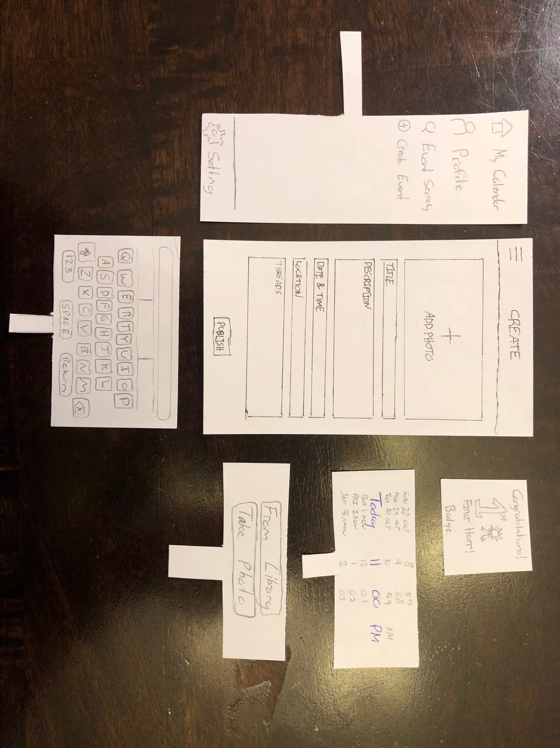
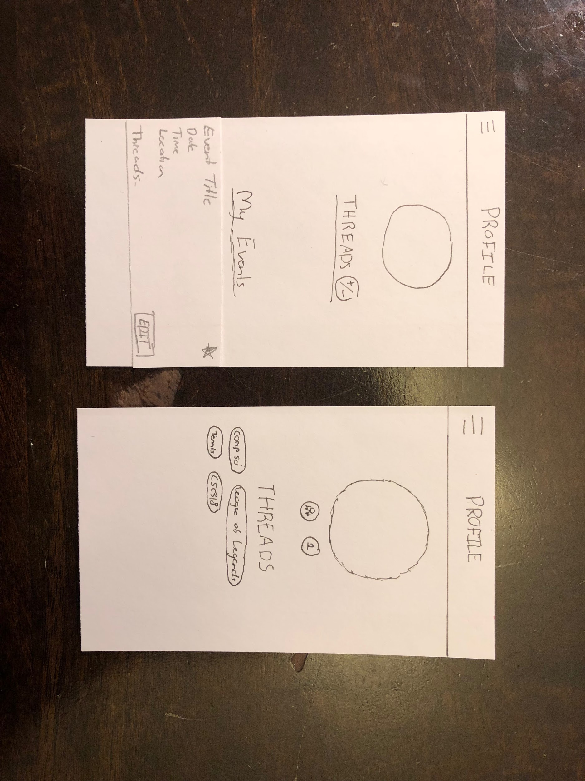
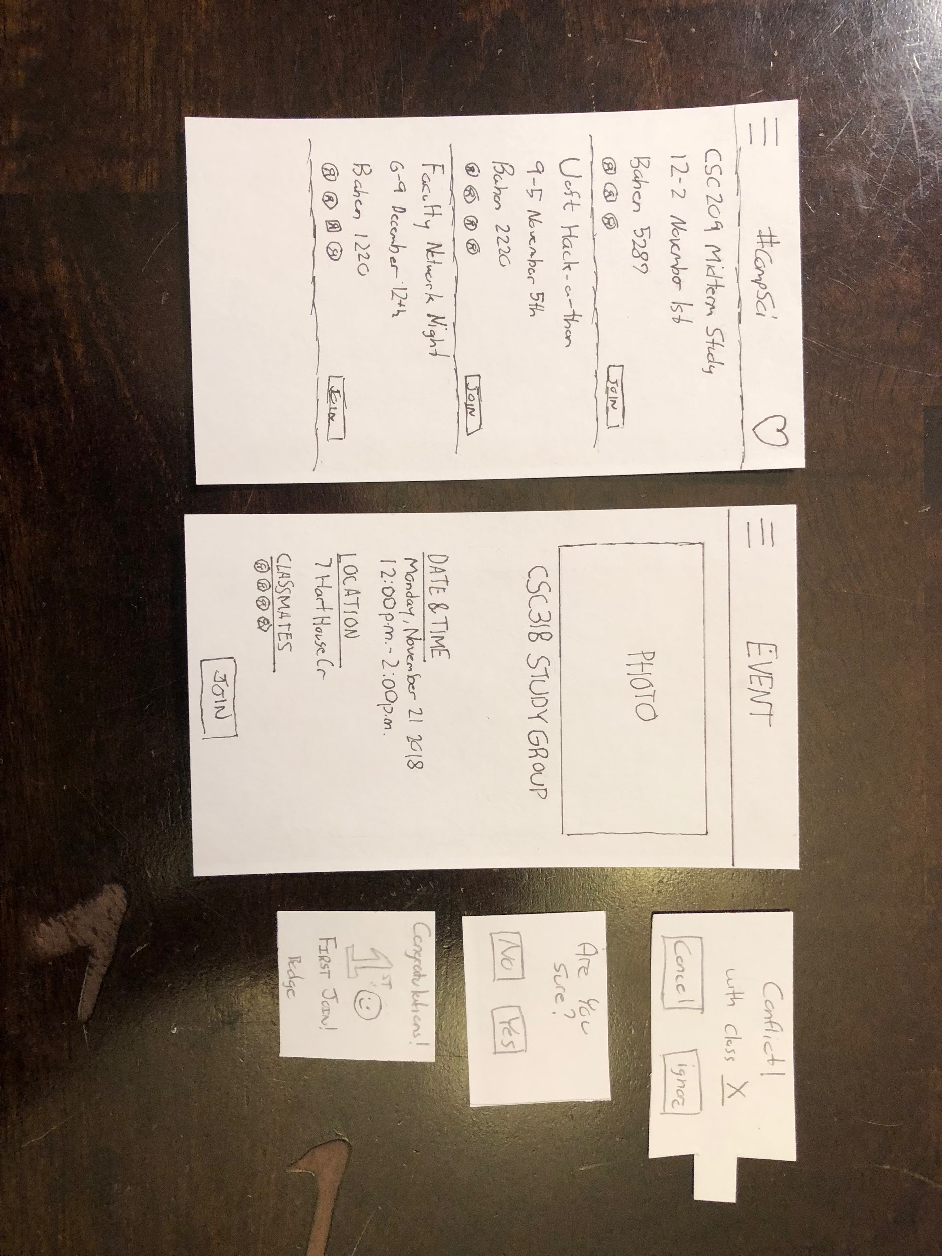
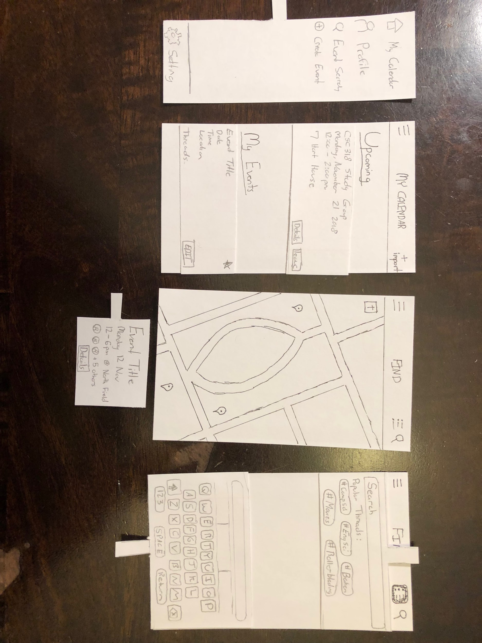
The Prototype
Notes:
Here we talk about how we pivoted from extension to mobile app from the feedback from studio...things like “acorn upload”, Hard to implement via Quercus etc...

Slide 21
Heuristic Evaluation
Visibility of system status
Match between system and the real world
User control and freedom
Consistency and standards
Error prevention
Recognition rather than recall
Flexibility and efficiency of use
Aesthetic and minimalist design
Help users recognize, diagnose, and recover from errors
Help and documentation

Slide 22


Visibility of System Status
Minimalistic design
Overall intuitive navigation
Wording/ icons are ambiguous
Unclear what actions were made
“My Events”
“Ignore”

Slide 23



System vs. Real World
Searching with a map
“My Calendar” as an page for events

Slide 24
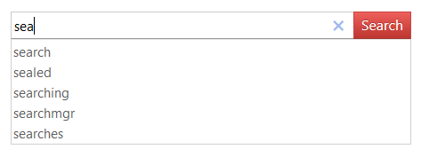
Help + Documentation
Problems:
Lots of functionality
Help should be provided for new users
Recommendations, suggestions

Slide 25
High-Fidelity
Usability Testing

Slide 26
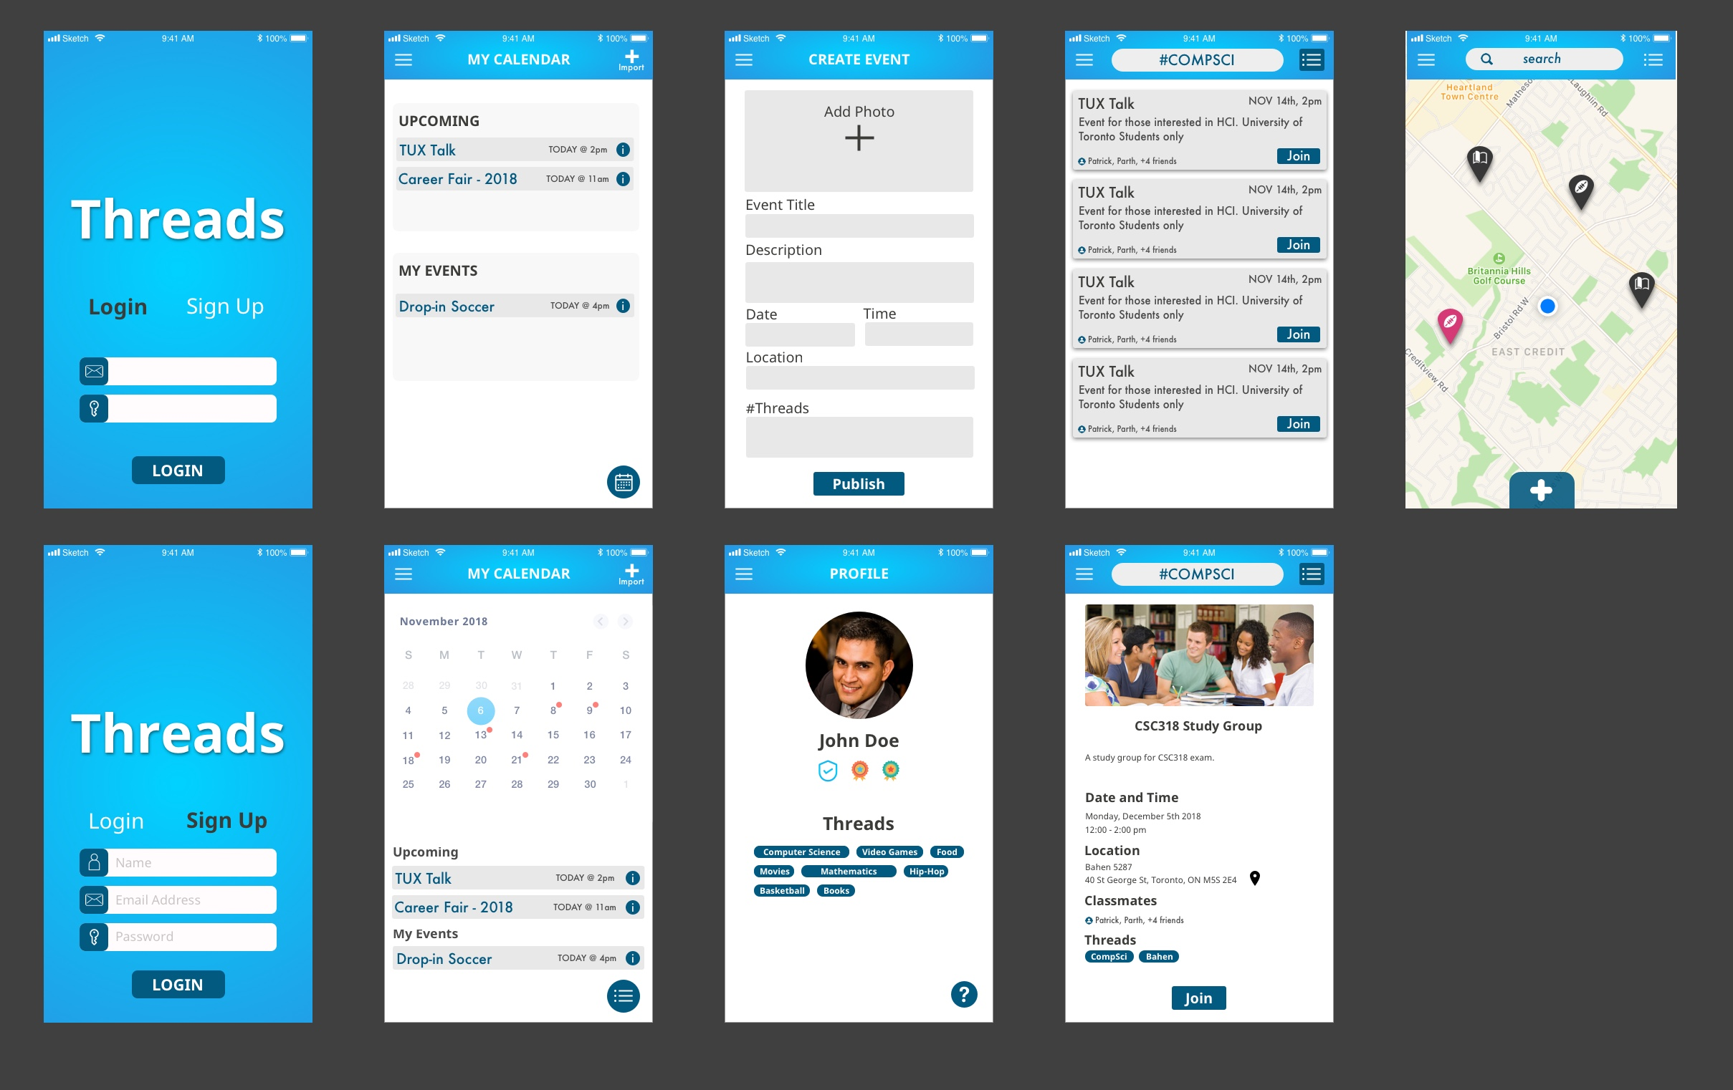

Slide 27
The Protocol - Tasks
Task 1 Profile + Subscribing:
Login using an account (for the purpose of this test use a random email and password).
Import and update your current schedule, look at the schedule.
Go into your profile and look at the threads you are subscribed to.
Look for a new thread called “compsci” and subscribe to it.
Find events that share the same “compsci” thread.
Return to your profile, look at the badges.
Task 2 Finding + Joining Events:
Look for events to join in the map view, find an sport event and read its description.
Go into the list view option to look at events available
Search for events in the compsci thread.
Read the description for “CSC309 review session”
Join the event called “CSC309 review session”
Try joining an event that conflict with your schedule.
Task 3 Creating Events:
Look for the page to create new events.
Type in the name, description, location and time for the event.
Type in the appropriate threads that applies to the event.
Publish the event.
Try to edit the event that you have created.
Look at the updates presented when searching for this event.
Notes:
Briefly mention our ta which is uoft students.. And then go into tasks… talk about how we put them into the mindset of the CHI theme. We wanna make sure that our app still functions of connecting students which is students being able to find and create join events...

Slide 28
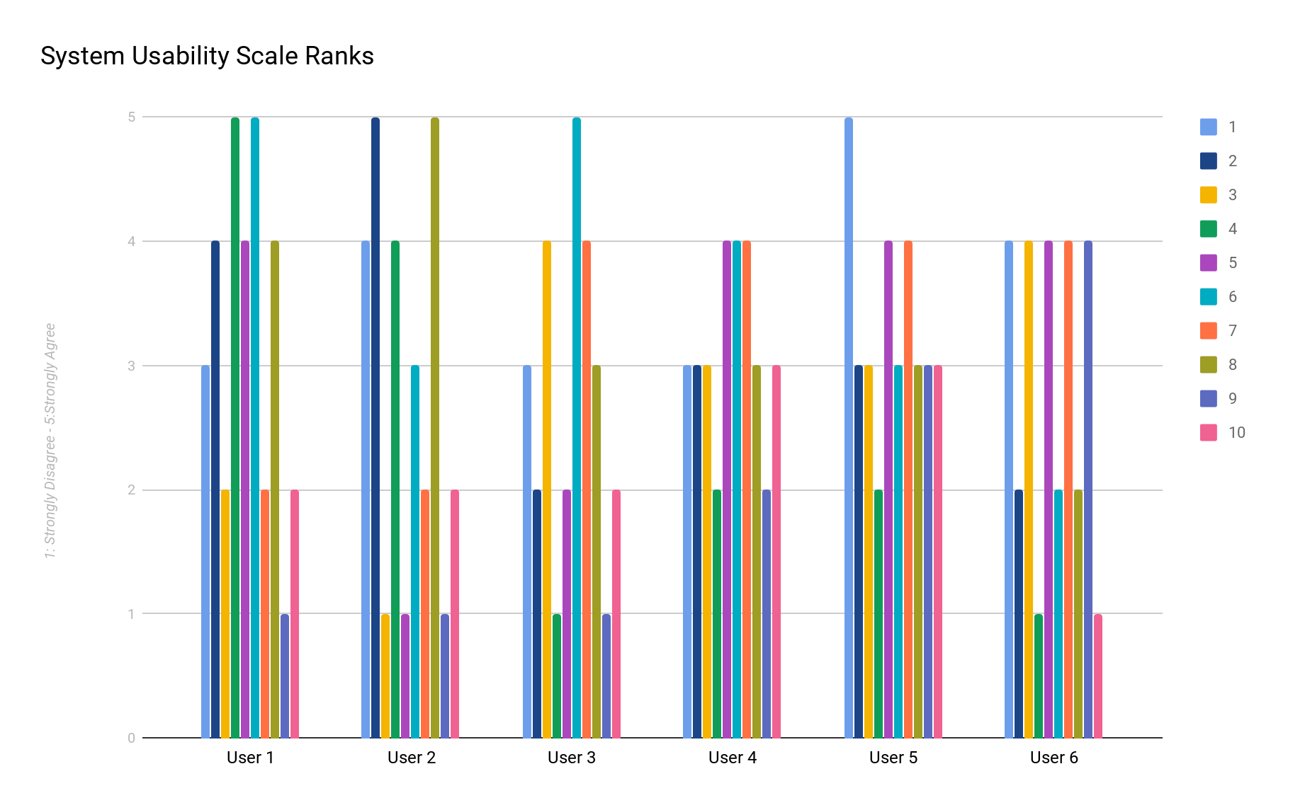

Slide 29
System Usability Scale
I think that I would like to use this system frequently.
I found the system unnecessarily complex.
I thought the system was easy to use.
I think that I would need the support of a technical person to be able to use this system.
I found the various functions in this system were well integrated.
I thought there was too much inconsistency in this system.
I would imagine that most people would learn to use this system very quickly.
I found the system very cumbersome to use.
I felt very confident using the system.
I needed to learn a lot of things before I could get going with this system.

Slide 30
Content
Likes
Navigation was a slight a problem
User can navigate between screens easily
Symbols and menu are recognizable
Finding and exploring events
Quick peek
Detailed view
Badges
Real-time status (success, errors)
Dislikes
Unsure how to manage threads
Badges seemed irrelevant
Only able to “upload” schedule
On map, can only see quick view events
Some functionalities not implemented yet
No clear explanation of “threads”

Slide 31
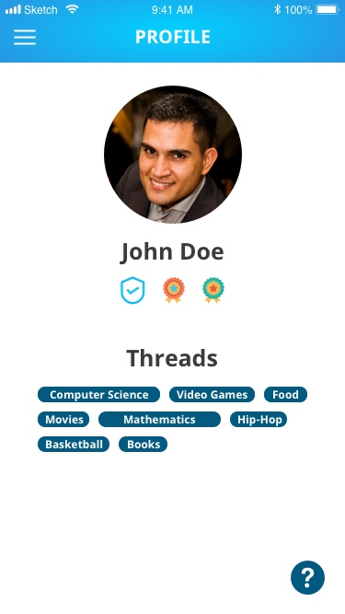
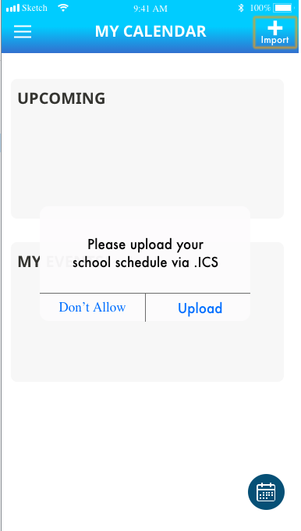
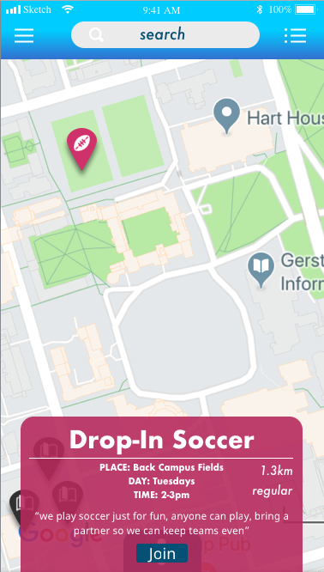

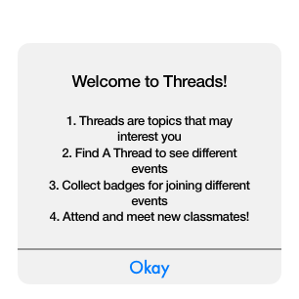
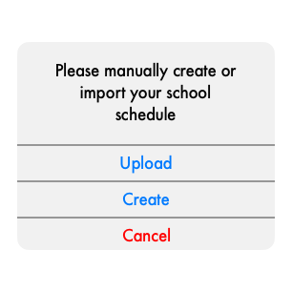
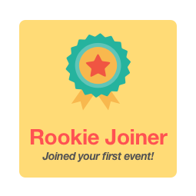
Notes:
I wanna change this

Slide 32
Demo
https://6gjdvp.axshare.com/login.html

Slide 33
Thank you!

